Slide 1
The Hardy Boys Casefiles Problem
Lecture 11

Slide 2
Wednesday, September 11th
National Make Your Bed Day
National Hot Cross Buns Day

Slide 3

The Hardy Boys Casefiles
Not the same as the original Hardy Boys Series
127 novel reboot from 1987-1998 with "higher stakes"
Hilariously terrible cover art
Lewiston City Library and Asotin County Library had a huge amount of these
One summer in elementary school I read 70 of them
I can guarantee you, they follow a formula
https://hardyboys.fandom.com/wiki/The_Hardy_Boys_Casefiles

Slide 4

Question
Could we build a machine learning model to predict if a given suspect in a Hardy Boys Casefile novel was the main villain?
What characteristics might we use as input?
https://www.abebooks.com/9780671700478/Power-Play-Hardy-Boys-Casefiles-0671700472/plp

Slide 5

Characteristics
Age
Gender
Occupation
Friendliness
Suspicion Level
Relationship to Protagonists
Average Proximity to Crime Scene(s)
https://www.amazon.com/Tagged-Terror-Hardy-Boys-Casefiles/dp/0671731122

Slide 6
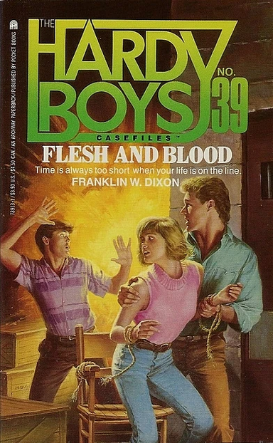
Dataset
Suspect name is the row identifier
Input features – Our characteristics
Output feature – Binary – Villain or not
127 novels * avg 4 suspects per novel = 508 instances to train on
https://hardyboys.fandom.com/wiki/Flesh_and_Blood

Slide 7

Machine Learning Model
Supervised Learning
Could do a test train split
Evaluate on Accuracy
https://www.hardyboyscasefiles.com/series/casefiles.php?book_no=22

Slide 8

How would this ML model do?
https://www.exlibrismichigan.com/products/the-hardy-boys-casefiles-88-inferno-of-fear-by-franklin-w-dixon

Slide 9
How would this ML model do?
You picked very reasonable features
https://www.exlibrismichigan.com/products/the-hardy-boys-casefiles-88-inferno-of-fear-by-franklin-w-dixon

Slide 10
How would this ML model do?
You picked very reasonable features
For the number of features, you should have plenty of examples
https://www.exlibrismichigan.com/products/the-hardy-boys-casefiles-88-inferno-of-fear-by-franklin-w-dixon

Slide 11
How would this ML model do?
You picked very reasonable features
For the number of features, you should have plenty of examples
Your dataset isn't terribly unbalanced (1/5-2/5 of the dataset has the villain class)
https://www.exlibrismichigan.com/products/the-hardy-boys-casefiles-88-inferno-of-fear-by-franklin-w-dixon

Slide 12
How would this ML model do?
You picked very reasonable features
For the number of features, you should have plenty of examples
Your dataset isn't terribly unbalanced (1/5-2/5 of the dataset has the villain class)
Unfortunately, this model would perform terribly
https://www.exlibrismichigan.com/products/the-hardy-boys-casefiles-88-inferno-of-fear-by-franklin-w-dixon

Slide 13
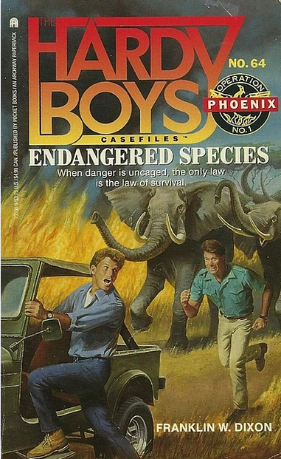
Why?
Because the writers of the Hardy Boys Casefiles surprisingly don't put in that much effort
https://hardyboys.fandom.com/wiki/Endangered_Species

Slide 14
Why?
Because the writers of the Hardy Boys Casefiles surprisingly don't put in that much effort
The formula for the Hardy Boys villains is very simple:
https://hardyboys.fandom.com/wiki/Endangered_Species

Slide 15
Why?
Because the writers of the Hardy Boys Casefiles surprisingly don't put in that much effort
The formula for the Hardy Boys villains is very simple:
  Introduced in first 30% of the novel
https://hardyboys.fandom.com/wiki/Endangered_Species

Slide 16
Why?
Because the writers of the Hardy Boys Casefiles surprisingly don't put in that much effort
The formula for the Hardy Boys villains is very simple:
  Introduced in first 30% of the novel
  Barely in the novel in next 30-60% of the novel
https://hardyboys.fandom.com/wiki/Endangered_Species

Slide 17
Why?
Because the writers of the Hardy Boys Casefiles surprisingly don't put in that much effort
The formula for the Hardy Boys villains is very simple:
  Introduced in first 30% of the novel
  Barely in the novel in next 30-60% of the novel
  Suddenly reappears at 70-75%
https://hardyboys.fandom.com/wiki/Endangered_Species

Slide 18
Why?
Because the writers of the Hardy Boys Casefiles surprisingly don't put in that much effort
The formula for the Hardy Boys villains is very simple:
  Introduced in first 30% of the novel
  Barely in the novel in next 30-60% of the novel
  Suddenly reappears at 70-75%
  Was the case in 60 out of the 70 novels I read
https://hardyboys.fandom.com/wiki/Endangered_Species

Slide 19
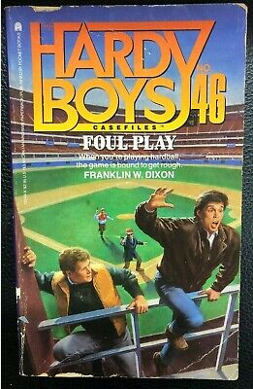
The Best Model in the World
Can't overcome bad data
Especially if the pattern you need is not in the data you are giving the model
https://www.ebay.com/itm/372988356522

Slide 20

Importance of Domain Expertise
If you read these novels, you will probably notice the pattern by your 5th book
But if you hadn't, it's not an obvious thing to track
You always want to work with a domain expert:
  To give you an idea if your outcome is present in the data
  To tell you about worthless values/how to clean
  To interpret your results
https://www.fantasticfiction.com/d/franklin-w-dixon/mission-mayhem.htm

Slide 21

Questions?
https://bookscouter.com/book/9780671882082-pure-evil-the-hardy-boys-casefiles-97

